Slide 1



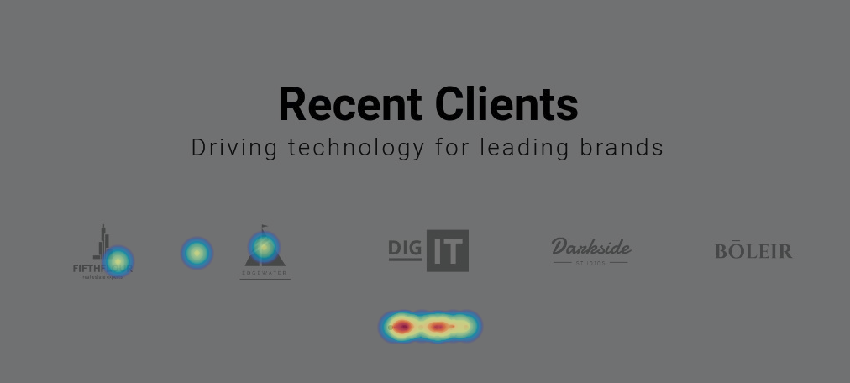
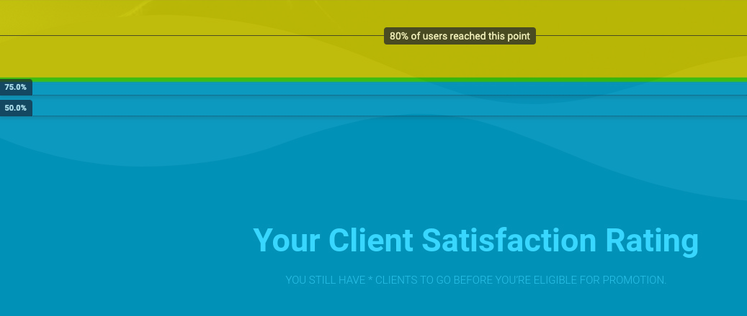

Research on Unique User Authentication via Behavioral Metrics
by Richard Carbone, Lazarus Bradley, and William Mullin
Abstract
Our research is to show the viability of analyzing user behavior, and using that information in order to identify unique users, similar to how a password would be used. These behaviors could be used to identify fraudulent usage of accounts, or other undetermined uses. An example could be that someone is using your Amazon account, but is behaving nothing like the way you usually behave while using the site. This research could help to flag that behavior, and identify the need for additional security measure to ensure the person is a legitimate user.
Methodology
In order to conduct this research, we needed a tool to track the movements and other key metrics of the survey’s subject. Given our desired time frame, designing those tools ourselves to fit our specific needs would be impractical, so we went with Hotjar, a tool made to work in conjunction with websites to gather this behavioral information. We designed a small website experience in WordPress as our testing environment, where we made a list of tasks for participants to complete. With the data collected from the observation of these tasks, we came to conclusions about the viability of using these metrics.
Screenshot of a section of our testing environment
Results and Conclusions
Through our experiment, we concluded that there is evidence to support the idea that users’ have differentiable profiles of behavior which can be quantified using tools such as heat maps and cursor movement trackers. We also believe the understanding of these profiles would benefit from further research in more controlled test environments.
Project Advisor,
Dr. Chasaki
Examples of heat maps and scroll maps gathered from our testing

